Slide 1
AI Driven Health and Lifestyle Monitoring With Python and Power BI
Graduation Research Project Defense
Faculty of Management and Business Intelligence

Slide 2
Project Team & Supervisors
Prepared By:
Ahmed Hatem El Sayed Mohamed (ID: 101907)
Ahmed Taher Mohamed Sobhy Ghanem (ID: 108689)
Mariem Hassan Mohamed Hassan (ID: 97947)
Nour Eldeen Mohamed Kamal (ID: 103727)
Yousef Ibrahim Yousef Gawish (ID: 102353)
Supervised By:
Dr. Rasha Mansor
TA. Nora Barakat

Slide 3
Project Agenda
01 Project Idea
What we built and why it matters
02 Problem & Objectives
The problem we solve and our goals
03 Literature Review
What researchers found before us
04 Dataset
155 health records: sleep, activity, stress
05 System Design
Use case, sequence diagram, Gantt chart
06 Implementation
Python code: data cleaning & ML models
07 ML Results
92% and 95.6% accuracy achieved
08 Power BI Dashboards
Health insights turned into visual reports
09 Significance & Contribution
Why this project is useful in real life
10 Conclusion & Future Work
Summary and what comes next

Slide 4
Project Idea
Build a machine learning model that connects health prediction with business analytics.
Collects daily activities, lifestyle habits, and health data to find patterns.
Uses Python for machine learning and Power BI for dashboards.

Slide 5
Problem Analysis
Modern life has created a major problem called “Self-Neglect” — people focus on work and study while ignoring sleep and physical activity.
Over time, this leads to stress, poor performance, and chronic diseases like heart problems and sleep disorders.
The biggest gap: most health tools only react after problems appear, not before — so people discover risks too late.
Our solution: a Machine Learning model (Random Forest + Logistic Regression) that finds hidden health risks from daily habits.
It gives early predictions so people can make better choices, reduce risks, and improve their quality of life.

Slide 6
Project Objectives
• Create a full machine learning Model to predict health risks.
Fix missing data problems in health records.
Use dashboards so supervisors can see results easily.
Help with early detection of health issues.

Slide 7
Dataset Description
Total Dataset Size: 155 individual health and lifestyle records.
Demographics: Age, Gender, Occupation.
Physiological: Heart Rate, Blood Pressure, BMI Category.
Behavioral: Sleep Duration, Quality of Sleep, Physical Activity, Stress Level.
Data Partitioning: 70% used for model training, 30% held out for evaluation and testing.

Slide 8
Guided Questions
1- What dataset did you use ?
2- Who can benefit from this project ?
3- What insights did you discover from the dataset ?
4- Why did you choose Logistic Regression ?
5- How can the project be improved in the future ?

Slide 9
Literature Review
Evolution of Health Monitoring Tools:
Phase 1: The Clinic Era | Braunwald (2015) (pp. 8, 26)
  Focus: Medical-grade diagnostics and physical indicators (pp. 13, 26).
  Tools: Clinical instruments (Stethoscopes, BP cuffs, EKG machines) (p. 26).
  Impact: Revolutionized internal measurements but captured only brief, isolated clinical snapshots (p. 26).
Phase 2: Going Digital | Shortliffe & Cimino (2014) (p. 26)
  Focus: Digital administrative transformation and records management (pp. 6, 26).
  Tools: Electronic Health Records (EHR) systems (p. 26).
  Impact: Migrated patient histories to computers but lacked predictive power or continuous tracking (p. 26).
Phase 3: Consumer Wearable | Patel (2026) & Shcherbina et al. (2017) (p. 26)
  Focus: Continuous, 24/7 personal biometric tracking (pp. 25-26).
  Tools: Smart watches and wrist-worn fitness trackers (Fit bit, Apple Watch) (pp. 13, 26).
  Impact: Generated massive streams of real-world health data without clinical validation (p. 26).
Phase 4: AI & Visual Analytics | Aversano et al. (2024) & Davenport & Harris (2017) (pp. 25-26)
  Focus: Predictive health intelligence and interactive diagnostics (pp. 6, 27).
  Tools: Python-based ML models (Random Forest, Logistic Regression) + Power BI (pp. 6, 31-32).
  Impact: Achieves up to 95.5% accuracy in sleep/risk tracking while lowering cognitive load via dashboards (pp. 27, 32).

Slide 10
System design and analysis

Slide 11
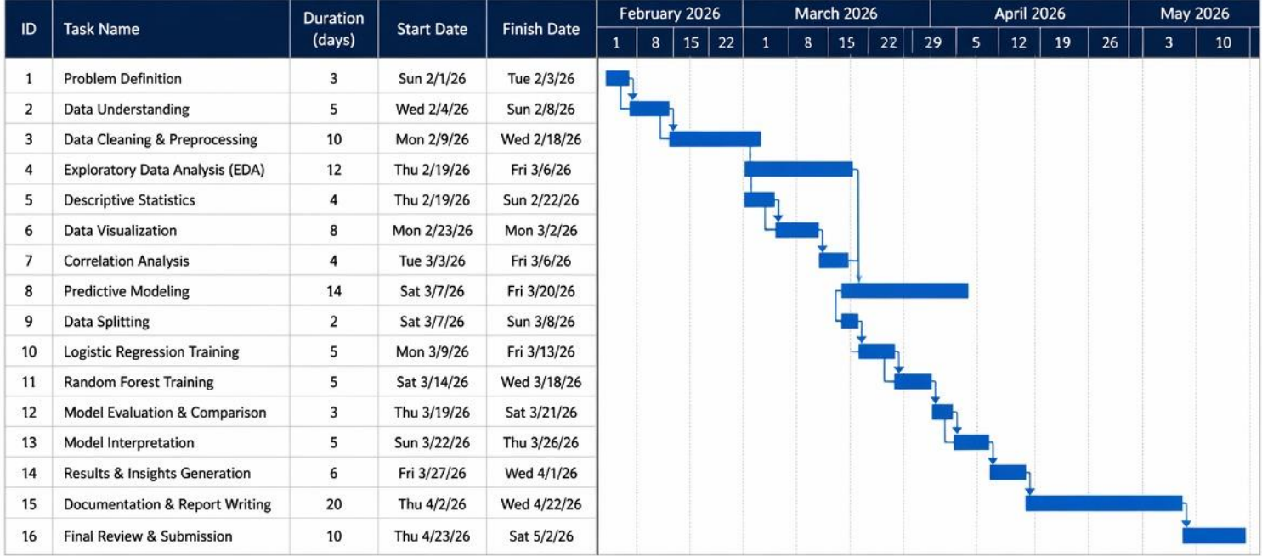
Project Scope & Implementation Timeline

Slide 12
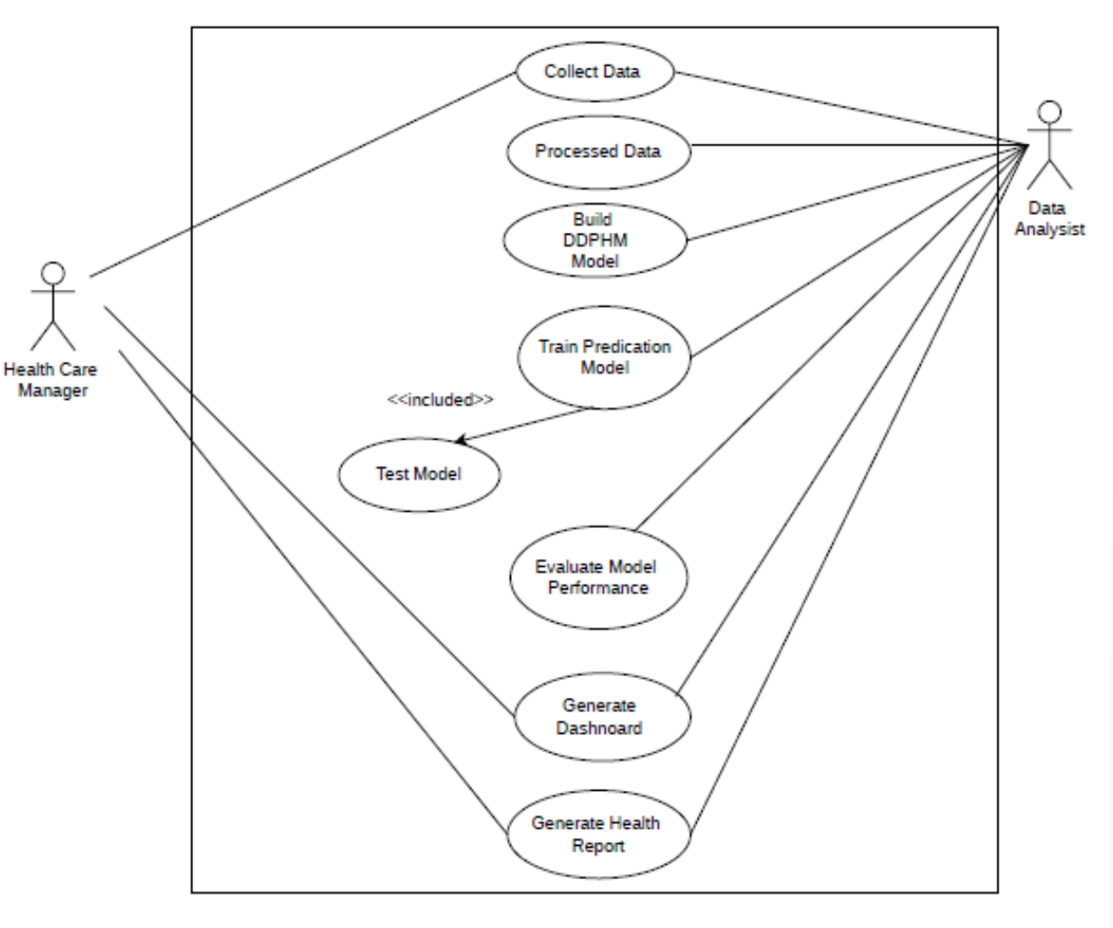
Use Case Diagram

Slide 13
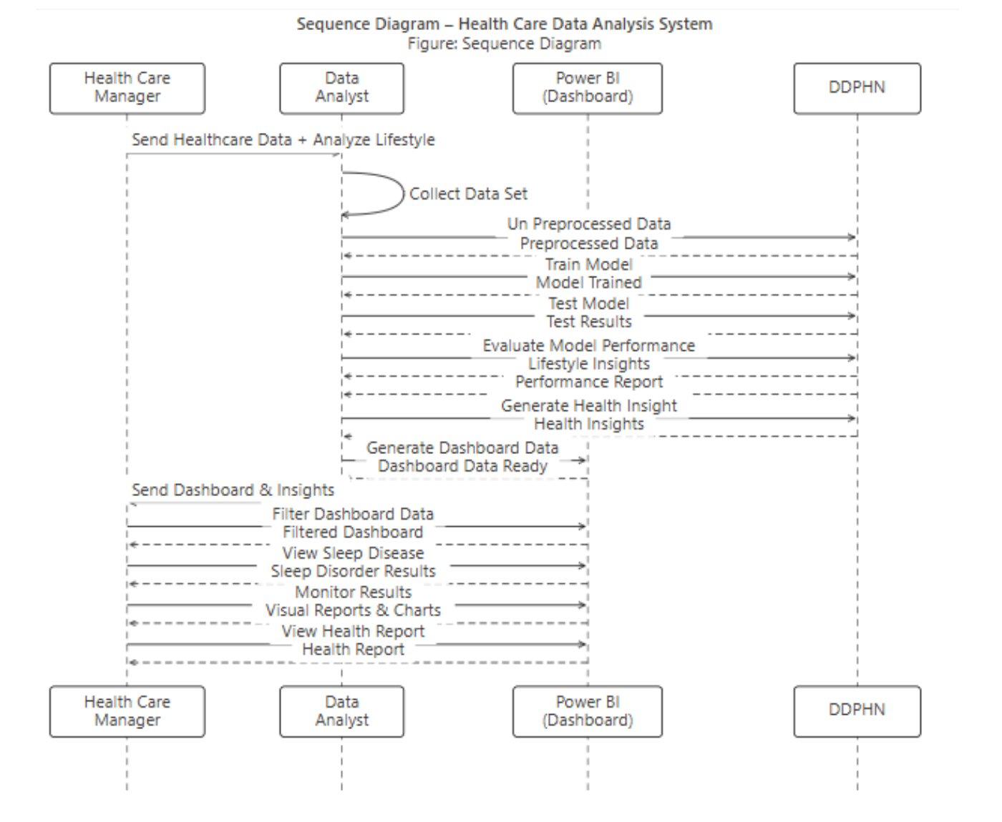
Sequence Diagram

Slide 14
Practical part using python

Slide 15
Machine Learning Results
Logistic Regression Model:
Overall Accuracy: 92.04%
Target Recall Rate: 95.50%
Random Forest Model:
Overall Accuracy: 95.58% (Superior performance).
Advantage: Handles complex, non-linear relationships.

Slide 16
Power BI Integration & Value
Interactive Visualization Layer: Converts Python predictive data into executive dashboards.
Managerial Impact: Allows healthcare or HR administrators to track risk distributions across specific age groups and occupations.
Actionable Outcomes: Drives targeted screening campaigns and corporate wellness resource allocation.

Slide 17
Project Significance
Our model reached 92% accuracy, proving it can reliably predict health risks.
It makes complex Python results simple by showing them in easy dashboards.
The project shows how technology can prevent health problems early; not just react after they happen.
This means fewer chronic diseases, better health awareness, and stronger productivity in professional life.

Slide 18
Contribution
We successfully combined AI prediction with business intelligence tools.
The project proves that machine learning can be used in real workplaces, not just research labs.
We Used Power BI interfaces that turn raw health data into clear insights, so even non‑technical managers can understand and act on them.
This contribution bridges the gap between data science and healthcare management, making advanced analytics practical and useful

Slide 19
Conclusion and future work

Slide 20
Conclusion
We built a health prediction model with Python and Power BI.
It moves healthcare from reactive to preventive.
By tracking sleep and activity, it predicts risks like sleep disorders and heart disease.
This helps people improve health, life quality, and productivity.
Future work: add real-time data for faster, more accurate insights.

Slide 21
Future Work
Add IoT devices like smartwatches and fitness trackers to collect live health data.
Move the system to the cloud so it can scale and support more users at once.
Strengthen data security with encryption and compliance standards to protect patient records.
Improve real‑time analysis for faster predictions and more accurate health insights.
Explore deep learning models for advanced risk detection and personalized recommendations

Slide 22
Thank You!
Questions & Academic Discussion

